Slide 1
The Allen AI Science Challenge or: Is your model smarter than an 8th grader?
Sean Osier
12/15/2015

Slide 2

The Problem
I have no idea what I’m doing.

Slide 3
The Challenge
Example Questions
When athletes begin to exercise, their heart rates and respiration rates increase. At what level of organization does the human body coordinate these functions?
at the tissue level
at the organ level
at the system level
at the cellular level
Which example describes a learned behavior in a dog?
smelling the air for odors
barking when disturbed
sitting on command
digging in soil
Notes:
Just the text
No internet

Slide 4



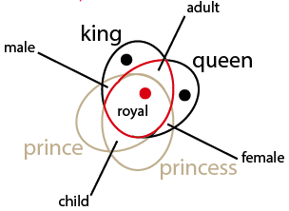
Approach
Approach
Random Guess
Simple Model
Wikipedia Corpus
+
Word2Vec
+

Slide 5
Simple Model
Approach
Random Guess
Simple Model
Wikipedia Corpus
+
Word2Vec
+

Slide 6

Simple Model
Simple (Rule-Based) Model
If “All / None of the Above”:
Else:
Always pick “A”

Slide 7
Word2Vec Model
Approach
Random Guess
Simple Model
Wikipedia Corpus
+
Word2Vec
+

Slide 8




Word2Vec Model
Word2Vec Model
Corpus
Word2Vec
Word2Vec
Simple Wiki
English Wiki
Textbook Glossaries
Answer | Score
A | 0.678
B | 0.601
C | 0.723
D | 0.599
+
+
Notes:
Talk about # articles scraped

Slide 9
Results
Kaggle Submissions
Currently ~37% = Top 20%
Word2Vec
“Simple” Model
Random Guess (~25%)
Notes:
Sporadic growth

Slide 10
Results
Kaggle Submissions
Competition Leader (~54%)
Currently ~37% = Top 20%
Word2Vec
“Simple” Model
Random Guess (~25%)
Notes:
Sporadic growth

Slide 11
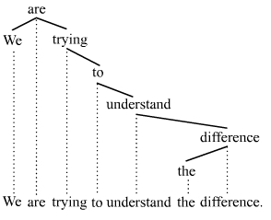
Opportunities for Improvement
Improved Question Analysis
Knowledge Graph

Slide 12
Thank You!
To Learn More About the Challenge:
https://www.kaggle.com/c/the-allen-ai-science-challenge
http://allenai.org/
To Learn More About Sean Osier:
Contact me at: sean@seanosier.com
https://www.linkedin.com/in/seanosier
https://github.com/sosier

Slide 13
Appendix

Slide 14
Word2Vec Model
Example
 | Raw | Computer Reads As | Similarity with Q
Question (Q) | Which cellular structure allows nutrients to pass into cells? | cellular structure allows nutrients pass cells | 100%
A | mitochondrion | mitochondrion | 58%
B | nucleus | nucleus | 56%
C | membrane | membrane | 76%
D | chloroplast | chloroplast | 61%
Notes:
Talk about # articles scraped

